Slide 1
Sentimental Analysis and Opinion Mining
PRESENTED BY:-
SUTHAR NEEL J (180170116046)
JAMNAL HARDIK (180170116014)
GUIDED BY: -
PROF. CHETNA CHAND

Slide 2

WHAT IS SENTIMENT ANALYSIS?
THE PROBLEM OF SENTIMENT ANALYSIS
SENTIMENT CLASSIFICATION
NLP
SUMMARY
INDEX

Slide 3
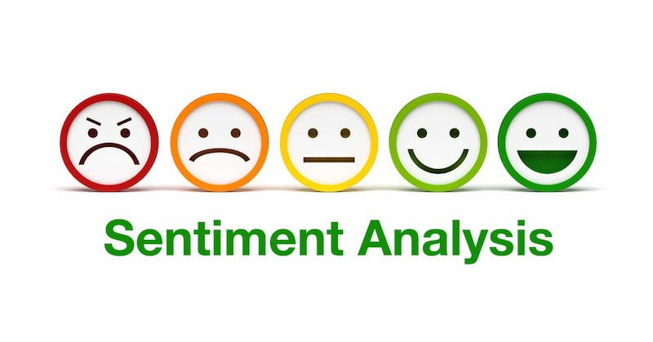
SENTIMENT ANALYSIS

Slide 4
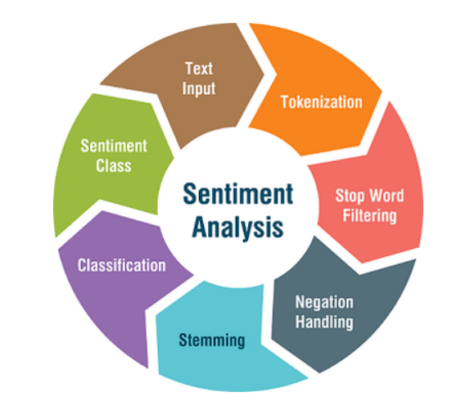
WHAT IS SENTIMENT ANALYSIS?
Sentiment analysis is a vital topic in the field of NLP. It has easily become one of the hottest topics in the field because of its relevance and the number of business problems it is solving and has been able to answer.
Sentiment analysis or sentiment classification fall into the broad category of text classification tasks where you are supplied with a phrase, or a list of phrases and your classifier is supposed to tell if the sentiment behind that is positive, negative or neutral.

Slide 5
WHY?
The promise of machine learning has shown many stunning results in a wide variety of fields. Natural language processing is no exception of it, and it is one of those fields where machine learning has been able to show general artificial intelligence (partially) achieving some brilliant results for genuinely complicated tasks.
There are a lot of uses for sentiment analysis, such as understanding how stock traders feel about a particular company by using social media data or aggregating reviews, movie reviews and twitter review so on.

Slide 6
EXAMPLE
SENTIMENT ANALYSIS
Consider the following phrases:
"Titanic is a great movie.“
"Titanic is not a great movie.“
"Titanic is a movie."

Slide 7
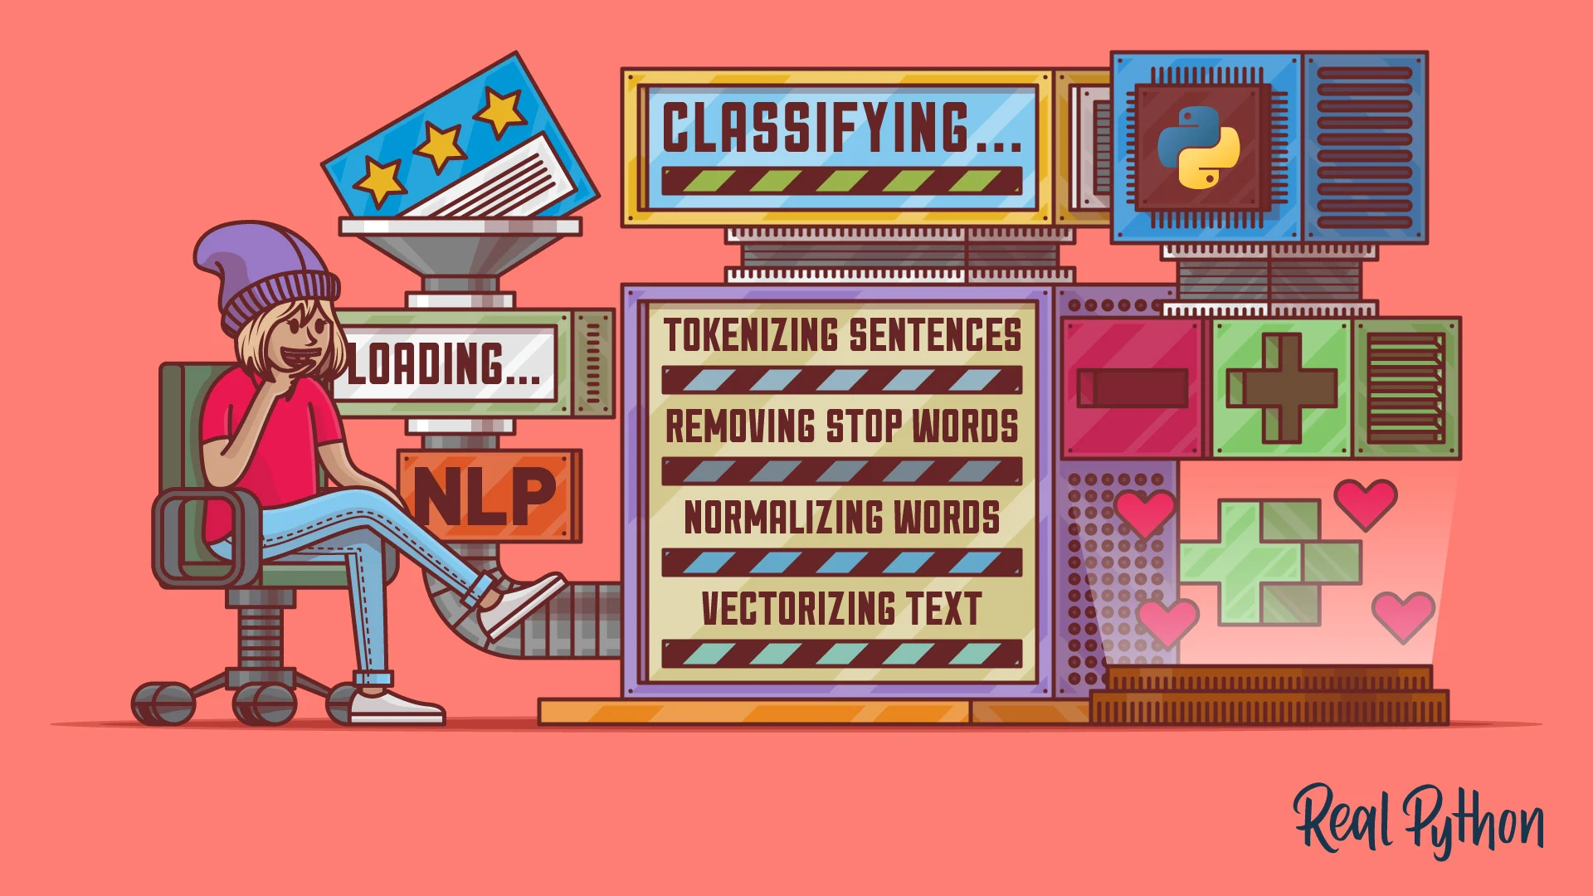
NLP
Natural Language Processing, or NLP for short, is broadly defined as the automatic manipulation of natural language, like speech and text, by software.
As machine learning practitioners interested in working with text data, we are concerned with the tools and methods from the field of Natural Language Processing.

Slide 8
NLP IN REAL LIFE
Information Retrieval(Google finds relevant and similar results).
Information Extraction(Gmail structures events from emails).
Machine Translation(Google Translate translates language from one language to another).
Text Simplification(Re wordify simplifies the meaning of sentences).
Sentiment Analysis(Hater News gives us the sentiment of the user).
Text Summarization(Summary or Reddit’s auto tldr gives a summary of sentences).
Spam Filter(Gmail filters spam emails separately).
Auto-Predict(Google Search predicts user search results).
Auto-Correct(Google Keyboard and Grammarly correct words otherwise spelled wrong).
Speech Recognition(Google Web Speech or Vocal ware).
Question Answering(Answers to a query).
Natural Language Generation(Generation of text from image or video data.)

Slide 9
STEPS IN NLP
Tokenizing sentences to break text down into sentences, words, or other units
Removing stop words like “if,” “but,” “or,” and so on
Normalizing words by condensing all forms of a word into a single form
Vectorizing text

Slide 10
TOKENIZING
Tokenization is the process of breaking down chunks of text into smaller pieces.
Word tokenization breaks text down into individual words.
Sentence tokenization breaks text down into individual sentences.
It gives structure to previously unstructured text.
FOR EXAMPLE:
Plata o Plomo-> ‘Plata’,’o’,’Plomo’.
What’s -> ‘what’,’is’.

Slide 11
REMOVING STOP WORDS
Stopwords are common words that will likely appear in any text.
They don’t tell us much about our data so we remove them.
For example:
silver or lead is fine for me-> silver, lead, fine.
With the stop words removed, the token list is much shorter, and there’s less context to help you understand the tokens.

Slide 12
NORMALIZING WORDS
Normalization is a little more complex than tokenization.
It entails condensing all forms of a word into a single representation of that word.
For instance, “watched,” “watching,” and “watches” can all be normalized into “watch.” There are two major normalization methods:
Stemming
Lemmatization

Slide 13
VECTORIZING TEXT
Vectorizing is the process of encoding text as integers i.e. numeric form to create feature vectors so that machine learning algorithms can understand our data.
There are mainly two methods for vectorizing text:
Vectorizing Data: Bag-Of-Words
Vectorizing Data: TF-IDF

Slide 14
THANK YOU

